Slide 1
Cluster Analysis Lecture 07
Taken from:
Dr Muhammad Atif Tahir
Professor

Slide 2
Last Week
Decision Tree
Support Vector Machine

Slide 3
Content
What is cluster
Applications of Cluster
Types of cluster
Conclusions

Slide 4
What is Cluster Analysis?
Finding groups of objects such that the objects in a group will be similar (or related) to one another and different from (or unrelated to) the objects in other groups
Inter-cluster distances are maximized
Intra-cluster distances are minimized

Slide 5
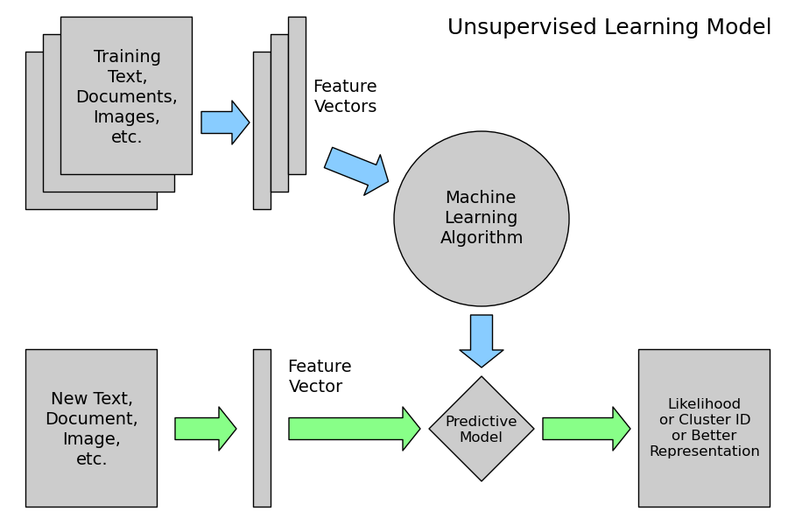
Unsupervised Learning

Slide 6
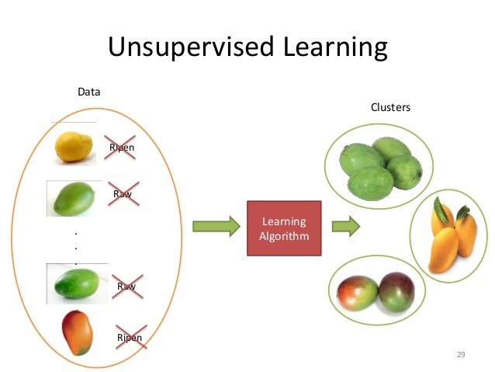
Applications of Cluster Analysis
Understanding
Group related documents for browsing, group genes and proteins that have similar functionality, or group stocks with similar price fluctuations
Summarization
Reduce the size of large data sets

Slide 7
Notion of a Cluster can be Ambiguous
How many clusters?
Six Clusters
Two Clusters
Four Clusters

Slide 8
Types of Clusterings
A clustering is a set of clusters
Important distinction between hierarchical and partitional sets of clusters
Partitional Clustering
A division data objects into non-overlapping subsets (clusters) such that each data object is in exactly one subset
Hierarchical clustering
A set of nested clusters organized as a hierarchical tree

Slide 9
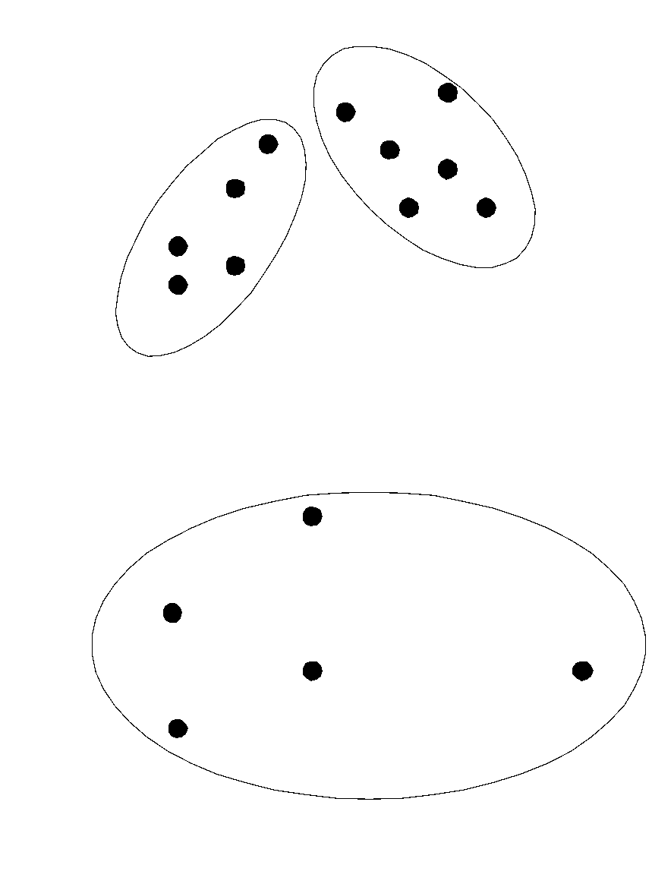
Partitional Clustering
Original Points
A Partitional Clustering

Slide 10
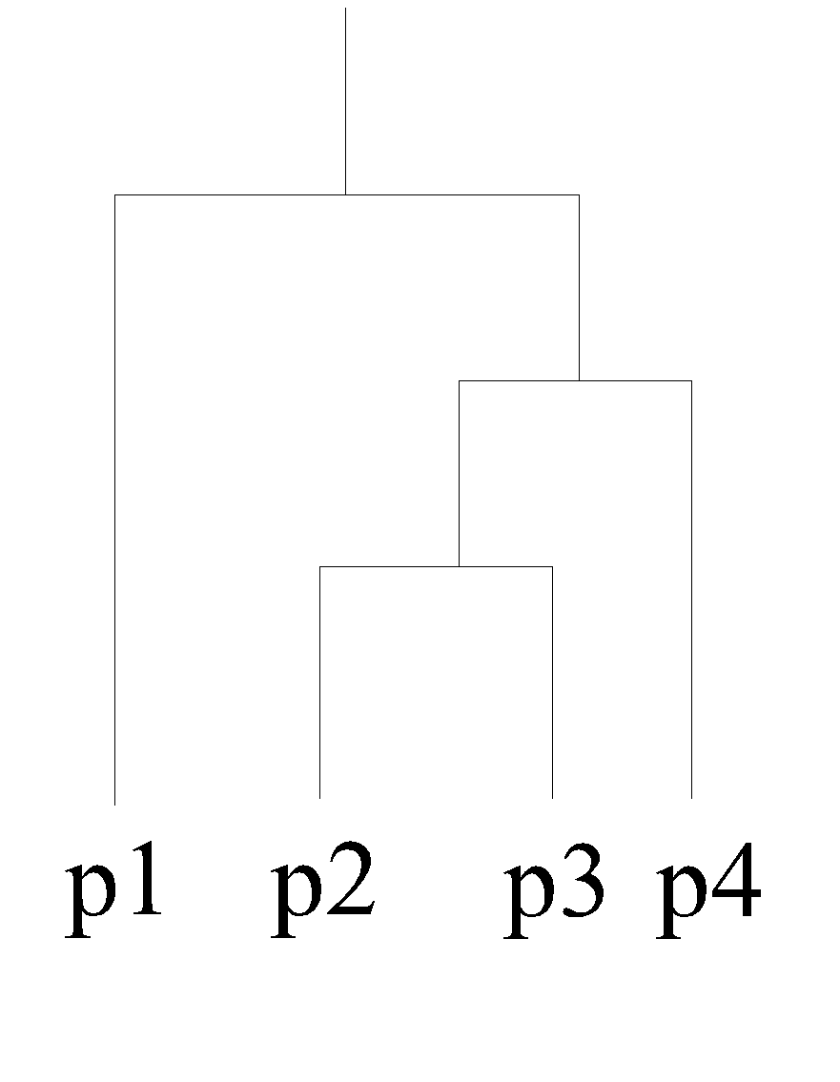
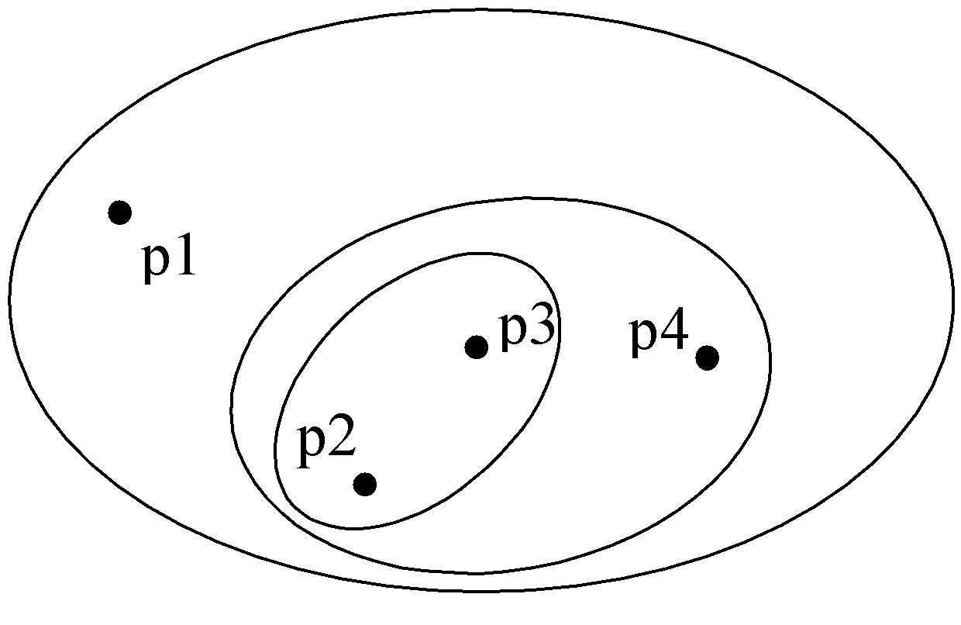
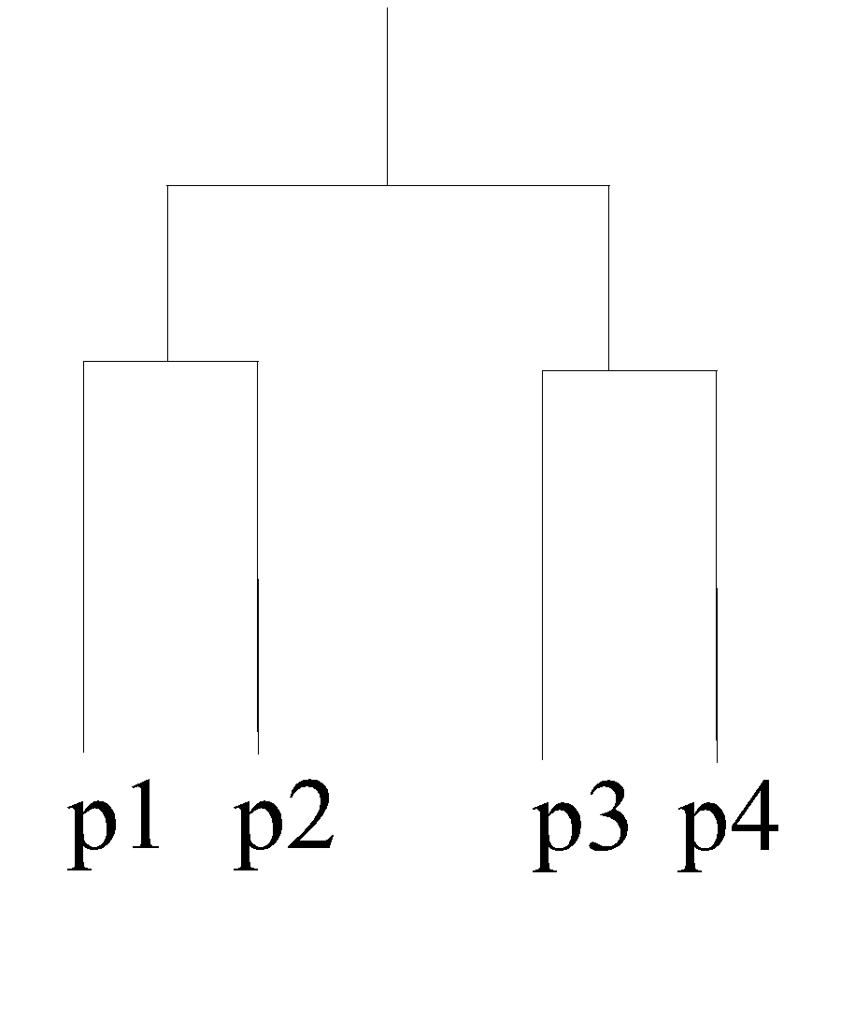
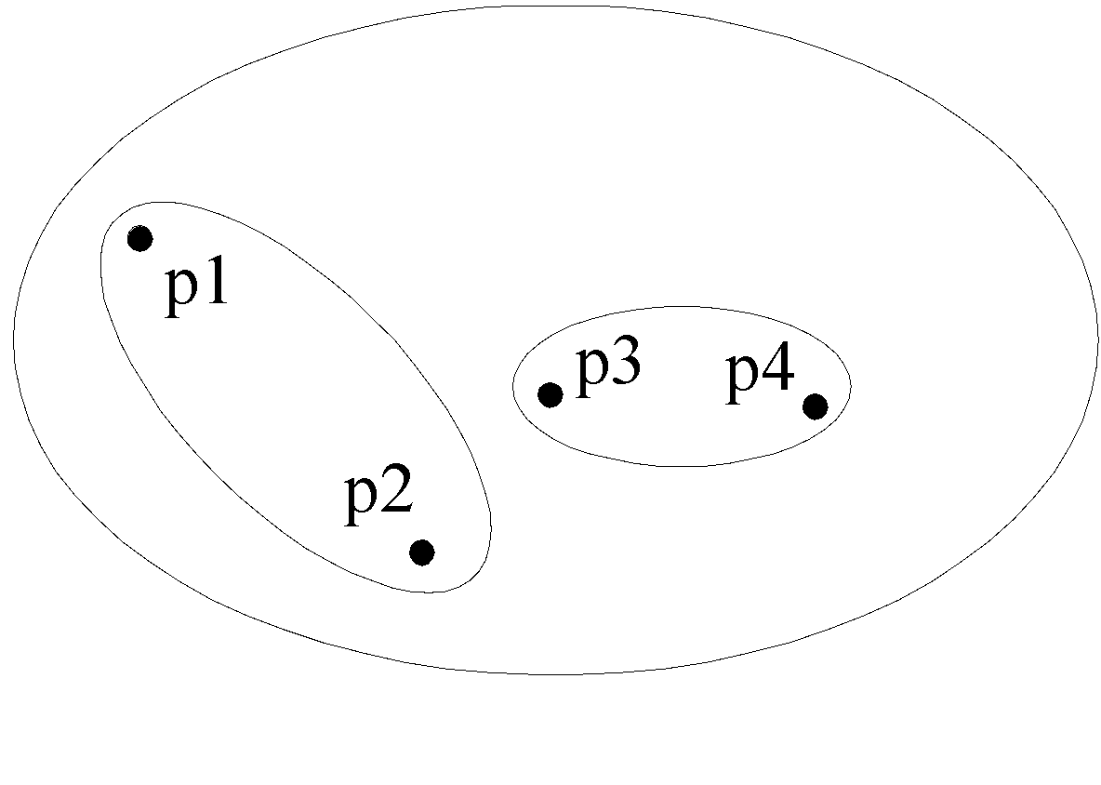
Hierarchical Clustering
Traditional Hierarchical Clustering
Traditional Dendrogram
Non-traditional Hierarchical Clustering
Non-traditional Dendrogram

Slide 11
Other Distinctions Between Sets of Clusters
Exclusive versus non-exclusive
In non-exclusive clusterings, points may belong to multiple clusters.
Can represent multiple classes or ‘border’ points
Fuzzy versus non-fuzzy
In fuzzy clustering, a point belongs to every cluster with some weight between 0 and 1
Weights must sum to 1
Probabilistic clustering has similar characteristics
Partial versus complete
In some cases, we only want to cluster some of the data
Heterogeneous versus homogeneous
Cluster of widely different sizes, shapes, and densities

Slide 12
Types of Clusters
Well-separated clusters
Contiguous clusters
Density-based clusters
Property or Conceptual
Described by an Objective Function

Slide 13
Types of Clusters: Well-Separated
Well-Separated Clusters:
A cluster is a set of points such that any point in a cluster is closer (or more similar) to every other point in the cluster than to any point not in the cluster.
3 well-separated clusters

Slide 14
Types of Clusters: Contiguity-Based
Contiguous Cluster (Nearest neighbor or Transitive)
A cluster is a set of points such that a point in a cluster is closer (or more similar) to one or more other points in the cluster than to any point not in the cluster.
8 contiguous clusters

Slide 15
Types of Clusters: Density-Based
Density-based
A cluster is a dense region of points, which is separated by low-density regions, from other regions of high density.
Used when the clusters are irregular or intertwined, and when noise and outliers are present.
6 density-based clusters

Slide 16
Types of Clusters: Conceptual Clusters
Shared Property or Conceptual Clusters
Finds clusters that share some common property or represent a particular concept.
.
2 Overlapping Circles

Slide 17
Types of Clusters: Objective Function
Clusters Defined by an Objective Function
Finds clusters that minimize or maximize an objective function.
Enumerate all possible ways of dividing the points into clusters and evaluate the `goodness' of each potential set of clusters by using the given objective function. (NP Hard)
Can have global or local objectives.
Hierarchical clustering algorithms typically have local objectives
Partitional algorithms typically have global objectives
A variation of the global objective function approach is to fit the data to a parameterized model.
Parameters for the model are determined from the data.
Mixture models assume that the data is a ‘mixture' of a number of statistical distributions.

Slide 18
Clustering Algorithms
Hierarchical Clustering
Agglomerative Algorithms
Divisive Algorithms
Others

Slide 19
Clustering Algorithms
Partitioning Algorithms
K-medoids
K-means
Probabilistic
Density based

Slide 20
Clustering Algorithms
Others
Evolutionary Heuristics
Grid Based
Artificial Neural Networks
Deep Learning

Slide 21
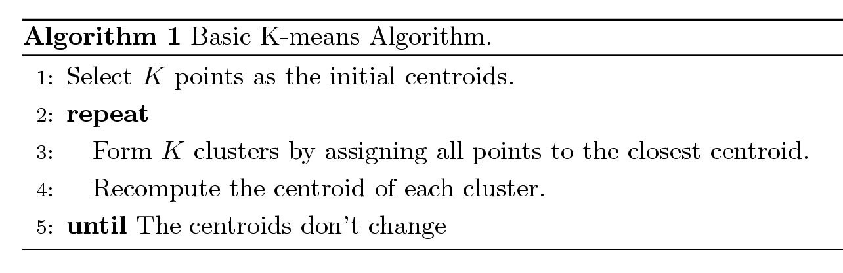
K-means Clustering
Partitional clustering approach
Each cluster is associated with a centroid (center point)
Each point is assigned to the cluster with the closest centroid
Number of clusters, K, must be specified
The basic algorithm is very simple

Slide 22
K-means Clustering – Details
Initial centroids are often chosen randomly.
Clusters produced vary from one run to another.
The centroid is (typically) the mean of the points in the cluster.
‘Closeness’ is measured by Euclidean distance, cosine similarity, correlation, etc.
K-means will converge for common similarity measures mentioned above.
Most of the convergence happens in the first few iterations.
Often the stopping condition is changed to ‘Until relatively few points change clusters’
Complexity is O( n * K * I * d )
n = number of points, K = number of clusters, I = number of iterations, d = number of attributes

Slide 23
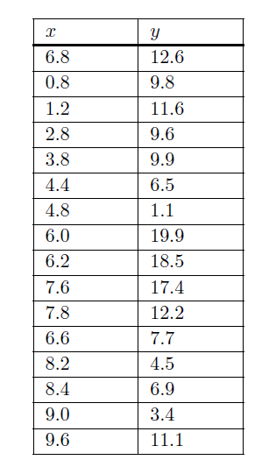
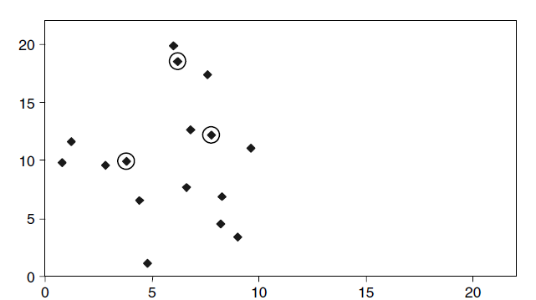
Example
k-means algorithm by using it
to cluster the 16 objects with two attributes x and y

Slide 24
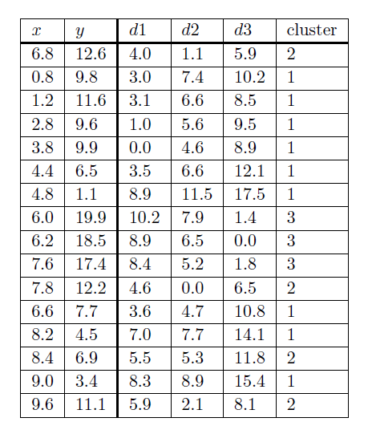
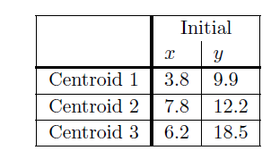

The columns headed d1, d2 and d3 in Figure shows the Euclidean distance
of each of the 16 points from the three centroids.
The column headed ‘cluster’ indicates the centroid closest to each point and
thus the cluster to which it should be assigned.
The distance of the first point (6.8, 12.6) from the first centroid (3.8, 9.9) is simply

Slide 25
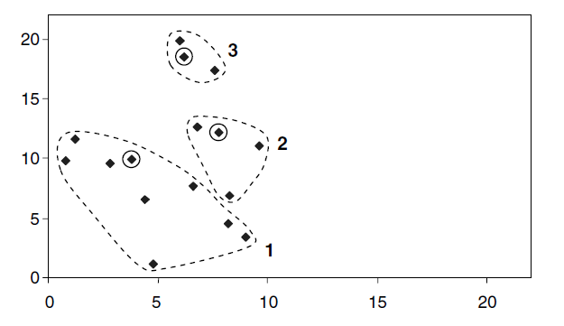
The resulting clusters after 1st Iteration

Slide 26
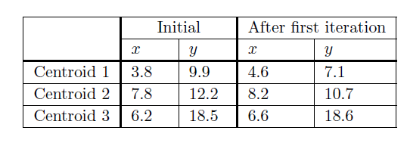
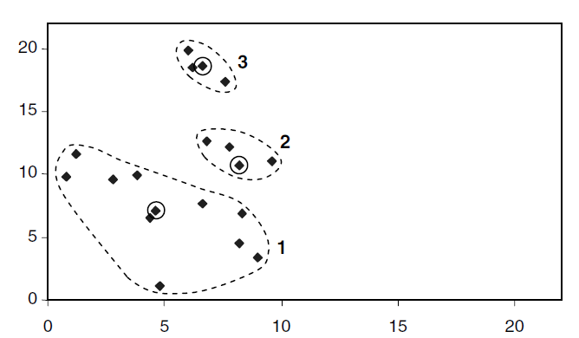
Centroids after 1st Iteration and Revised Cluster

Slide 27
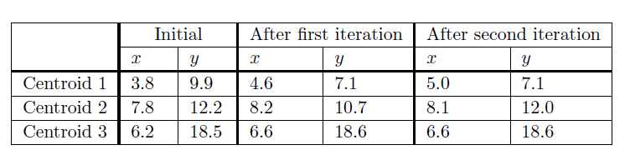
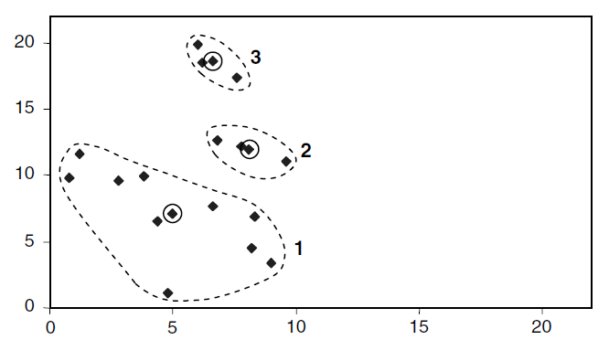
After 2nd Iteration and Third Set of Clusters
These are the same clusters as before. Their centroids will be the same as those from which the clusters were generated.
Hence the termination condition of the k-means algorithm ‘repeat ... until the centroids no longer move’ has been met and these are the final clusters produced by the algorithm for the initial choice of centroids made.

Slide 28
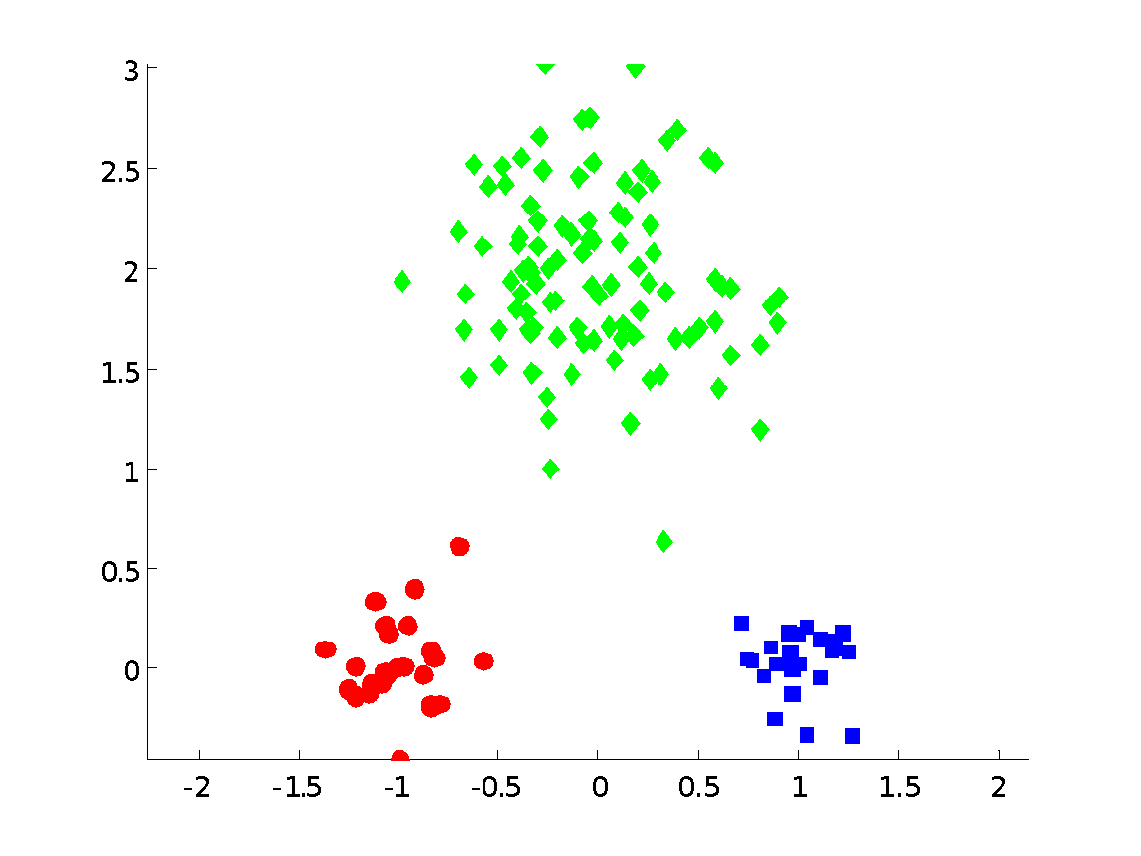
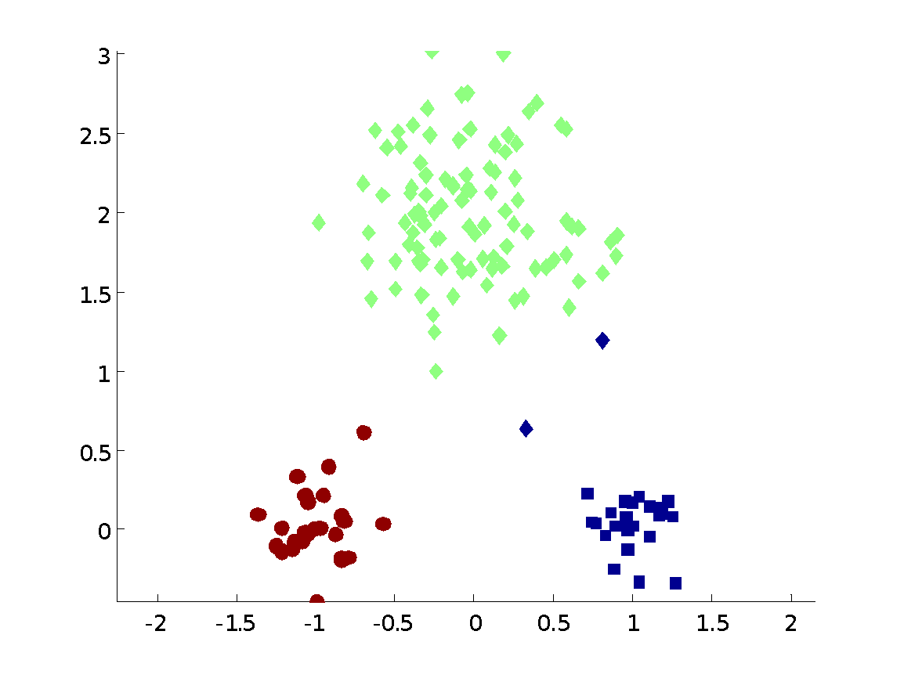
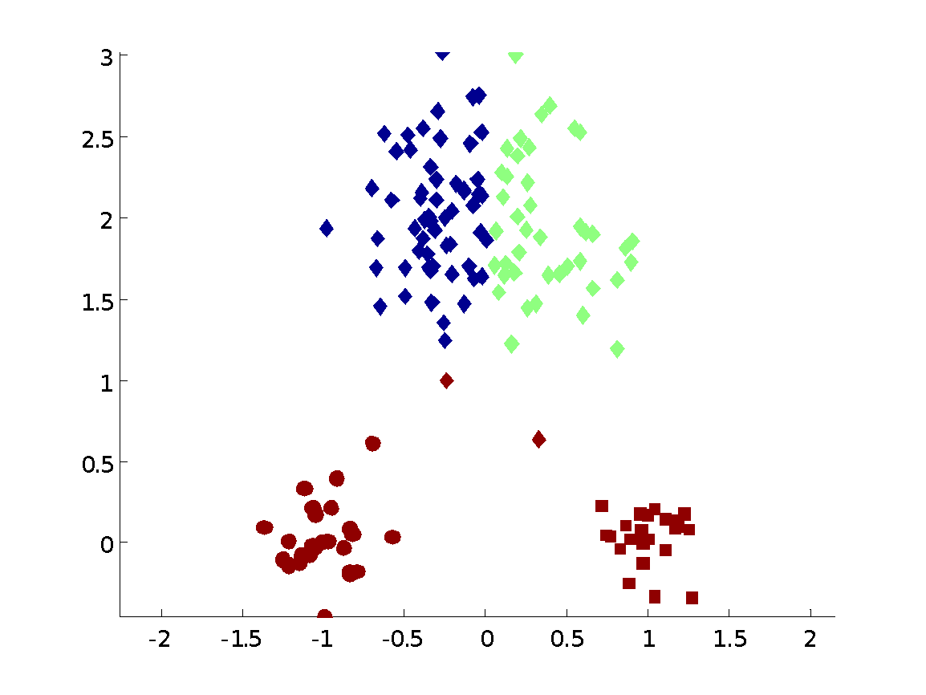
Two different K-means Clusterings
Original Points
Optimal Clustering
Sub-optimal Clustering

Slide 29
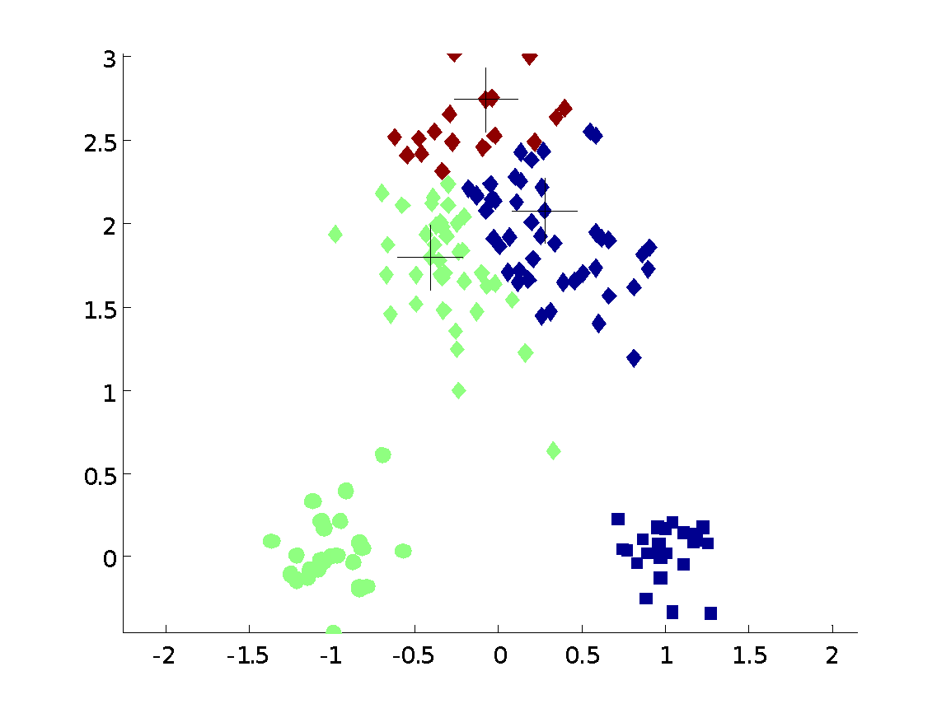
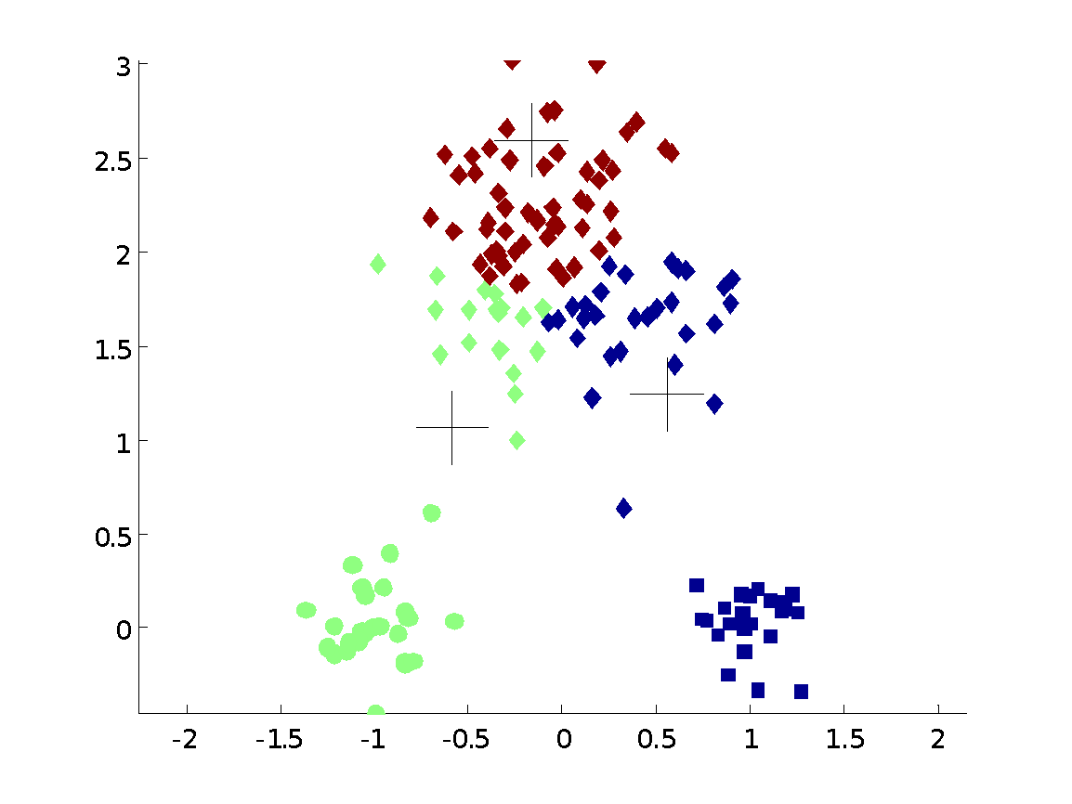
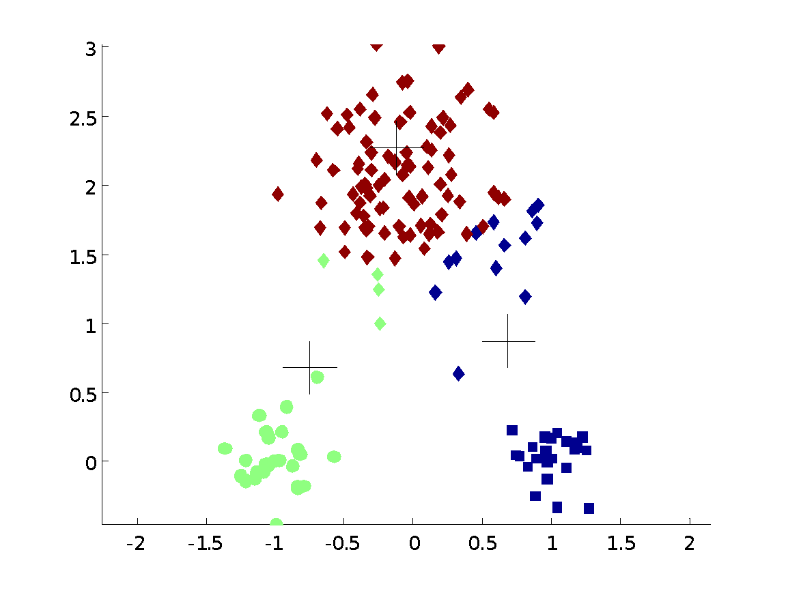
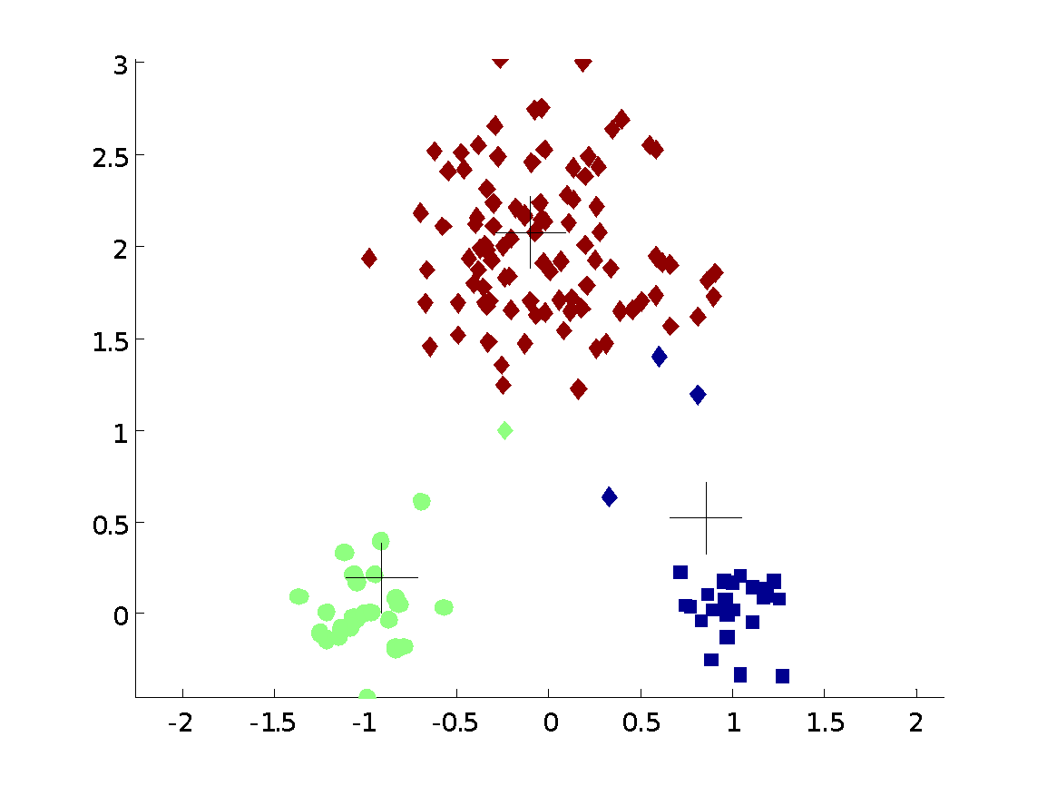


Importance of Choosing Initial Centroids

Slide 30
Importance of Choosing Initial Centroids

Slide 31

Evaluating K-means Clusters
Most common measure is Sum of Squared Error (SSE)
SSE is the sum of the squared differences between each observation and its group's mean. It can be used as a measure of variation within a cluster. If all cases within a cluster are identical the SSE would then be equal to 0.
Where n is the number of observations, x_{i} is the value of the ith observation and is the mean of all the observations. This can also be rearranged to be written as seen in J.H. Ward's paper.
Given two clusters, we can choose the one with the smallest error
One easy way to reduce SSE is to increase K, the number of clusters

Slide 32
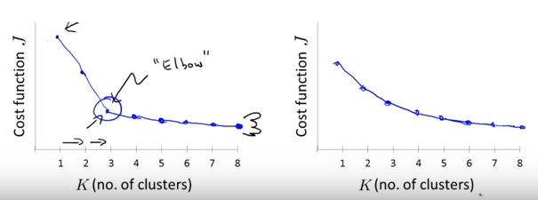
Elbow Method

Slide 33
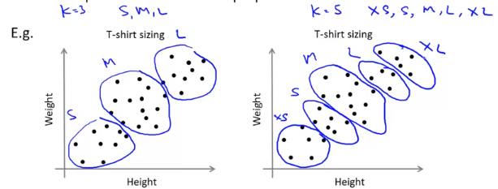
Choosing K based on a metric for how well it performs for the later purpose

Slide 34
Solutions to Initial Centroids Problem
Multiple runs
Helps, but probability is not on your side
Sample and use hierarchical clustering to determine initial centroids
Select more than k initial centroids and then select among these initial centroids
Select most widely separated

Slide 35
Limitations of K-means
K-means has problems when clusters are of differing
Sizes
Densities
Non-globular shapes
K-means has problems when the data contains outliers.

Slide 36
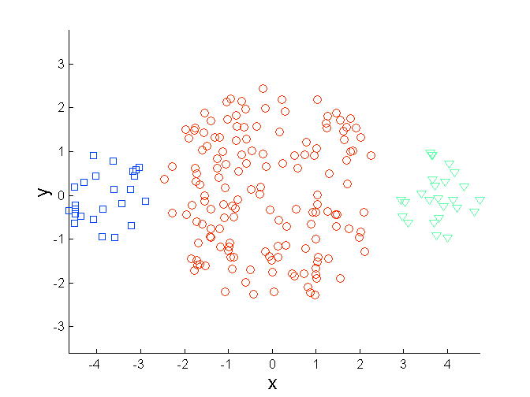
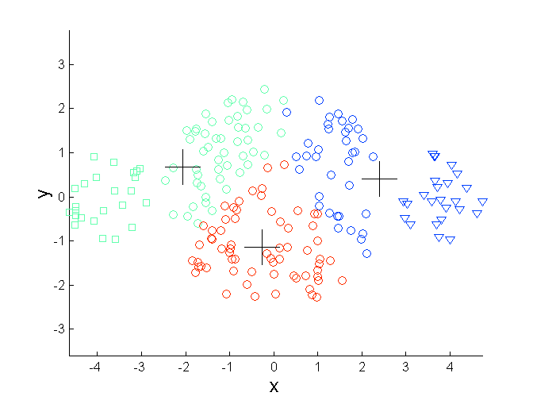
Limitations of K-means: Differing Sizes
Original Points
K-means (3 Clusters)

Slide 37
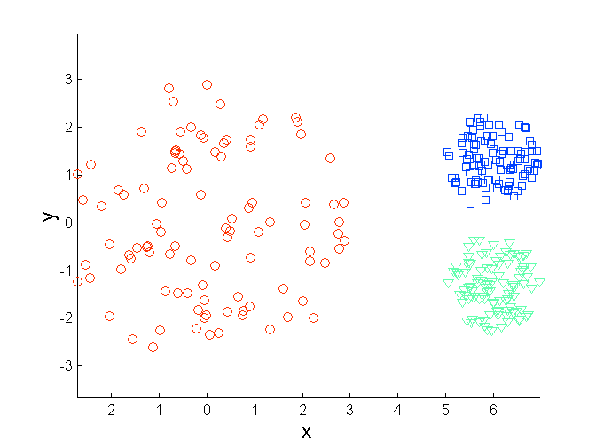
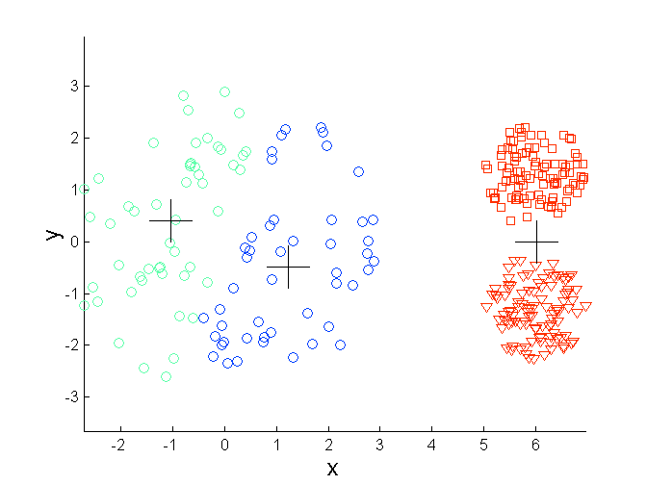
Limitations of K-means: Differing Density
Original Points
K-means (3 Clusters)

Slide 38
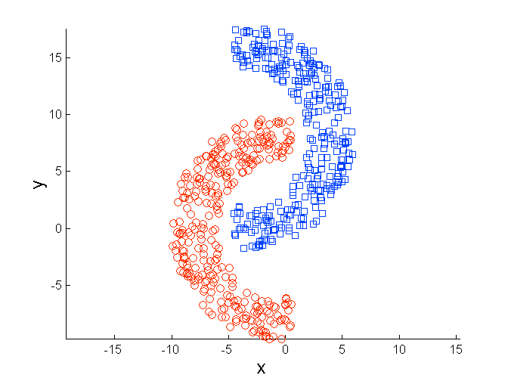
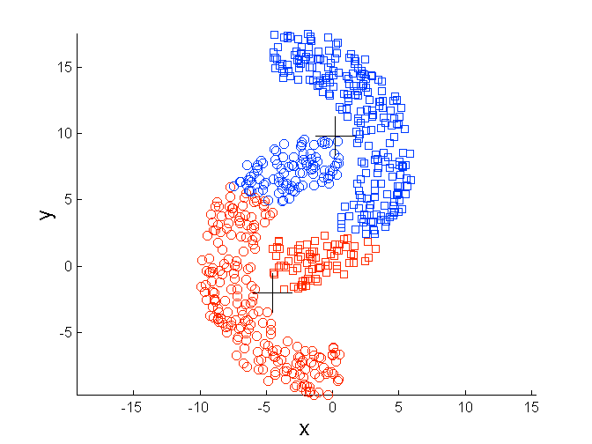
Limitations of K-means: Non-globular Shapes
Original Points
K-means (2 Clusters)

Slide 39
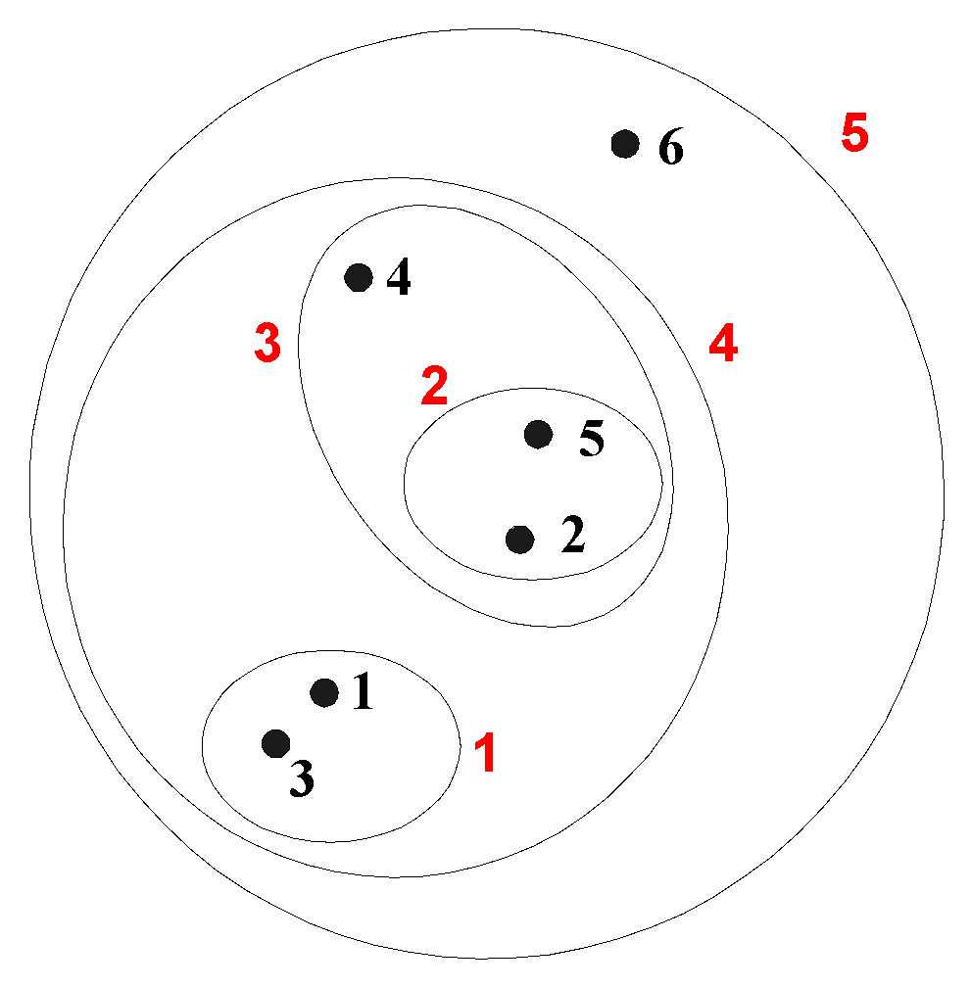
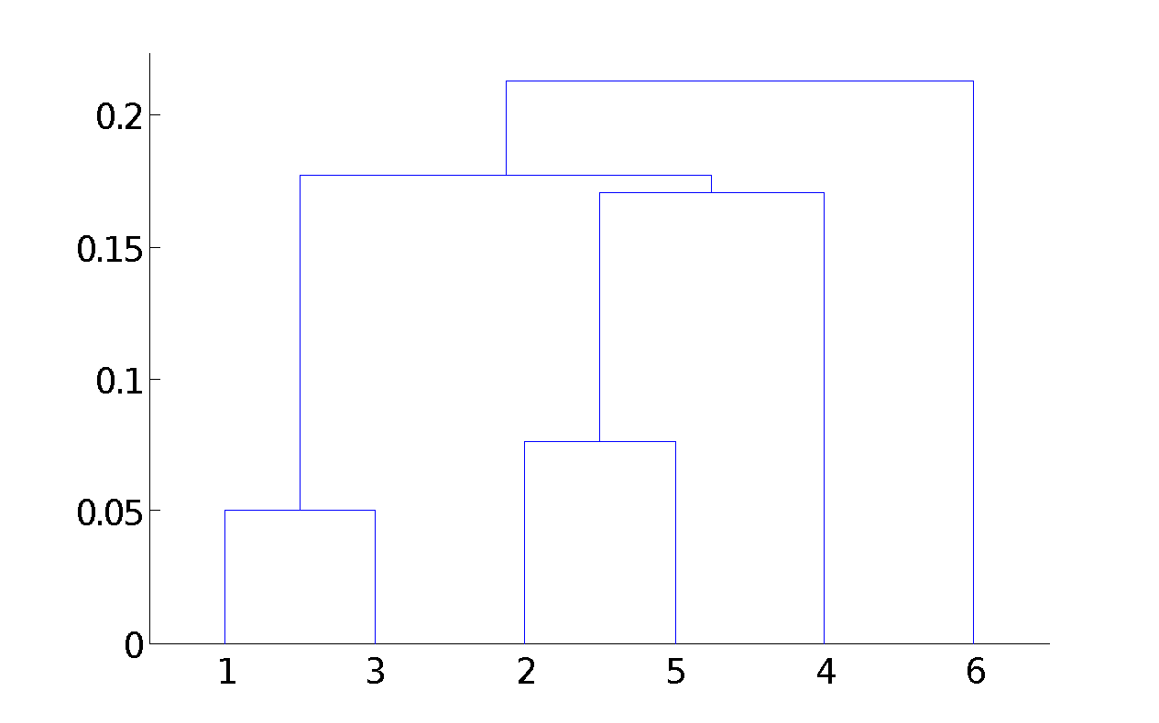
Hierarchical Clustering
Produces a set of nested clusters organized as a hierarchical tree
Can be visualized as a dendrogram
A tree like diagram that records the sequences of merges or splits

Slide 40
Strengths of Hierarchical Clustering
Do not have to assume any particular number of clusters
Any desired number of clusters can be obtained by ‘cutting’ the dendogram at the proper level
They may correspond to meaningful taxonomies
Example in biological sciences (e.g., animal kingdom, phylogeny reconstruction, …)

Slide 41
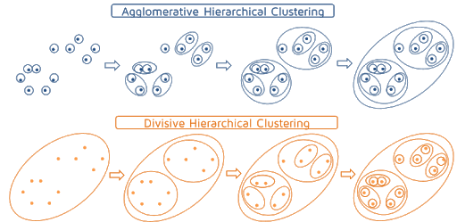
Hierarchical Clustering
Two main types of hierarchical clustering
Agglomerative:
Start with the points as individual clusters
At each step, merge the closest pair of clusters until only one cluster (or k clusters) left
Divisive:
Start with one, all-inclusive cluster
At each step, split a cluster until each cluster contains a point (or there are k clusters)
Traditional hierarchical algorithms use a similarity or distance matrix
Merge or split one cluster at a time

Slide 42
Agglomerative Clustering Algorithm
More popular hierarchical clustering technique
Basic algorithm is straightforward
Compute the proximity matrix
Let each data point be a cluster
Repeat
Merge the two closest clusters
Update the proximity matrix
Until only a single cluster remains
Key operation is the computation of the proximity of two clusters
Different approaches to defining the distance between clusters distinguish the different algorithms

Slide 43
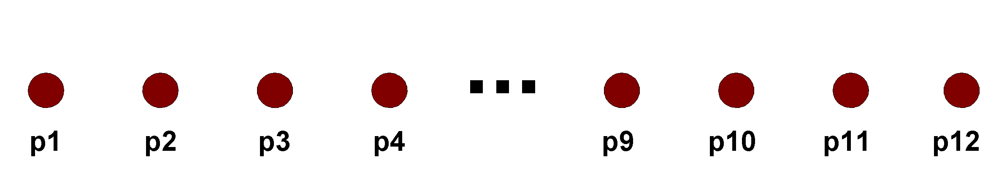
Starting Situation
Start with clusters of individual points and a proximity matrix
p1
p2
p3
p4
p5
. . .
p1
p2
p3
p4
p5
.
.
.
Proximity Matrix

Slide 44
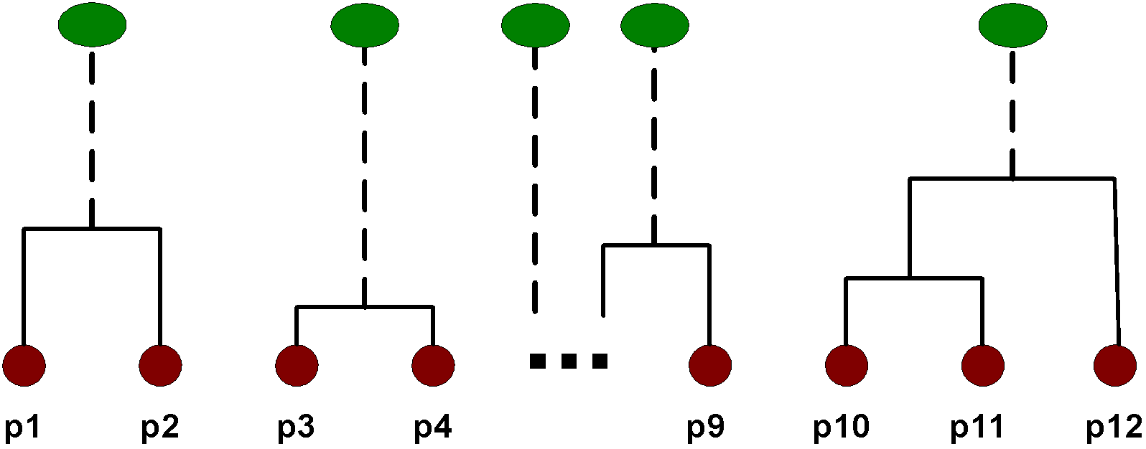
Intermediate Situation
After some merging steps, we have some clusters
C1
C2
C3
C4
C5
C1
C2
C3
C3
C4
C4
C5
Proximity Matrix
C1
C2
C5

Slide 45
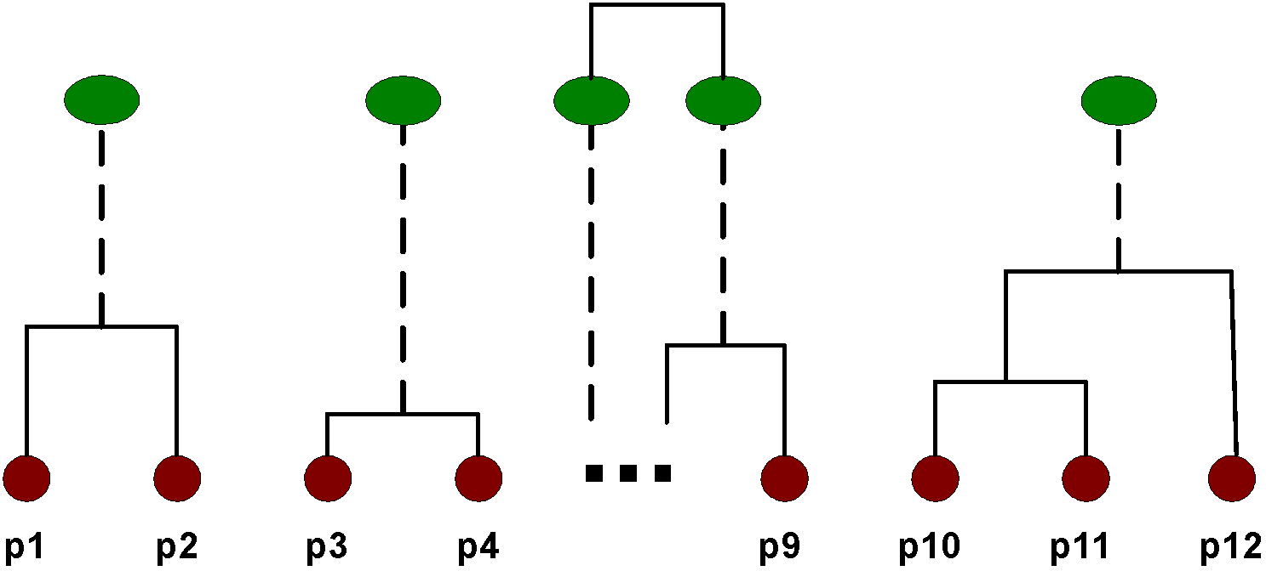
Intermediate Situation
We want to merge the two closest clusters (C2 and C5) and update the proximity matrix.
C1
C2
C3
C4
C5
C1
C2
C3
C3
C4
C4
C5
Proximity Matrix
C1
C2
C5

Slide 46
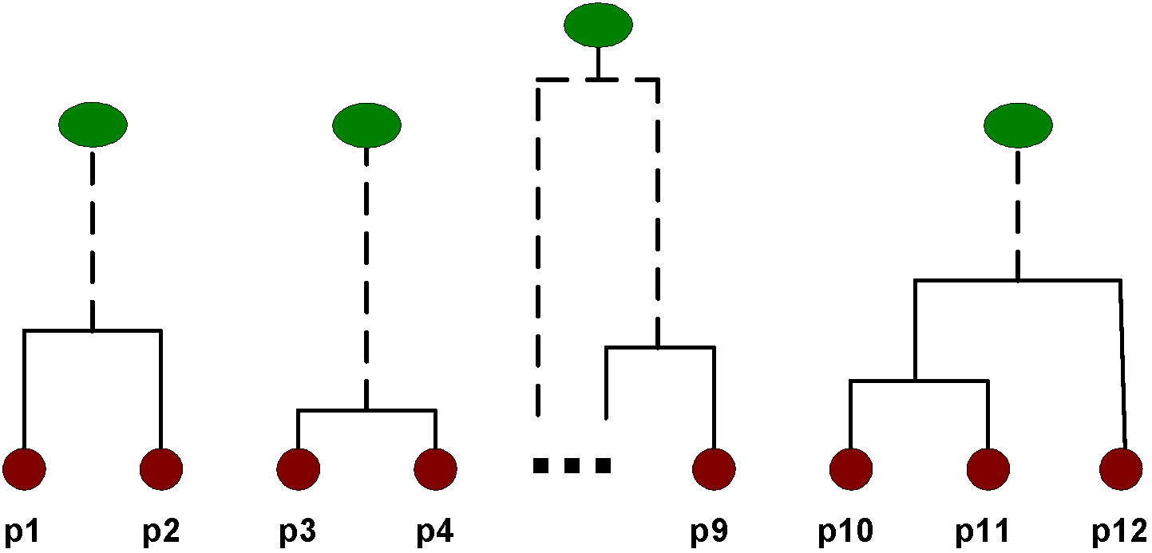
After Merging
The question is “How do we update the proximity matrix?”
C2 U C5
C1
C3
C4
C1
?
C2 U C5
? ? ? ?
C3
C3
?
C4
C4
?
Proximity Matrix
C1
C2 U C5

Slide 47
How to Define Inter-Cluster Similarity
p1
p2
p3
p4
p5
. . .
p1
Similarity?
p2
p3
p4
p5
MIN
MAX
Group Average
Distance Between Centroids
Other methods driven by an objective function
Ward’s Method uses squared error
.
.
.
Proximity Matrix

Slide 48
How to Define Inter-Cluster Similarity
p1
p2
p3
p4
p5
. . .
p1
p2
p3
p4
p5
MIN
MAX
Group Average
Distance Between Centroids
Other methods driven by an objective function
Ward’s Method uses squared error
.
.
.
Proximity Matrix

Slide 49
How to Define Inter-Cluster Similarity
p1
p2
p3
p4
p5
. . .
p1
p2
p3
p4
p5
MIN
MAX
Group Average
Distance Between Centroids
Other methods driven by an objective function
Ward’s Method uses squared error
.
.
.
Proximity Matrix

Slide 50
How to Define Inter-Cluster Similarity
p1
p2
p3
p4
p5
. . .
p1
p2
p3
p4
p5
MIN
MAX
Group Average
Distance Between Centroids
Other methods driven by an objective function
Ward’s Method uses squared error
.
.
.
Proximity Matrix

Slide 51
How to Define Inter-Cluster Similarity
p1
p2
p3
p4
p5
. . .
p1
×
×
p2
p3
p4
p5
MIN
MAX
Group Average
Distance Between Centroids
Other methods driven by an objective function
Ward’s Method uses squared error
.
.
.
Proximity Matrix

Slide 52
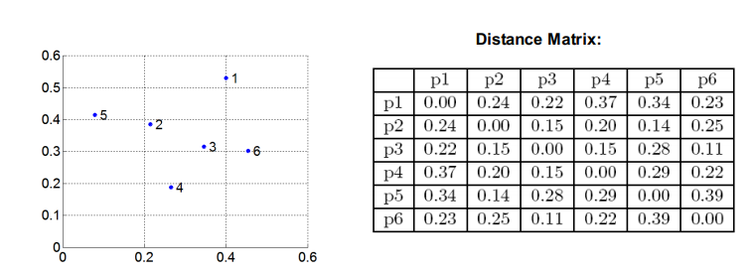
Cluster Similarity: MIN or Single Link
Similarity of two clusters is based on the two most similar (closest) points in the different clusters
Determined by one pair of points, i.e., by one link in the proximity graph.

Slide 53
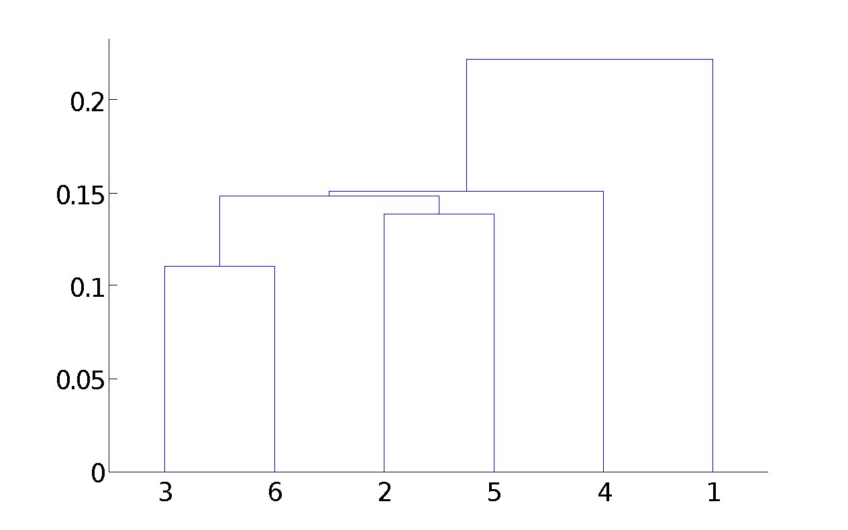
Hierarchical Clustering: MIN
5
1
3
5
2
1
2
3
6
4
4
Nested Clusters
Dendrogram

Slide 54
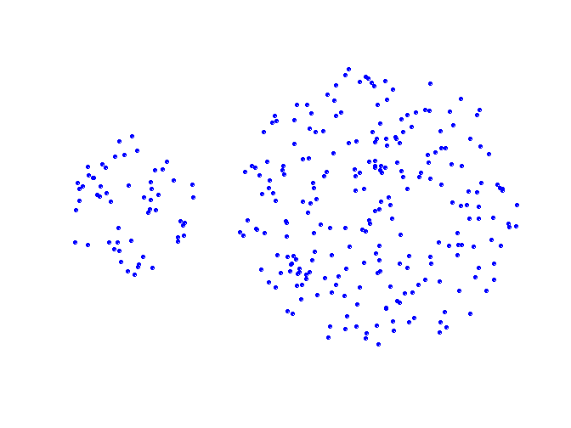
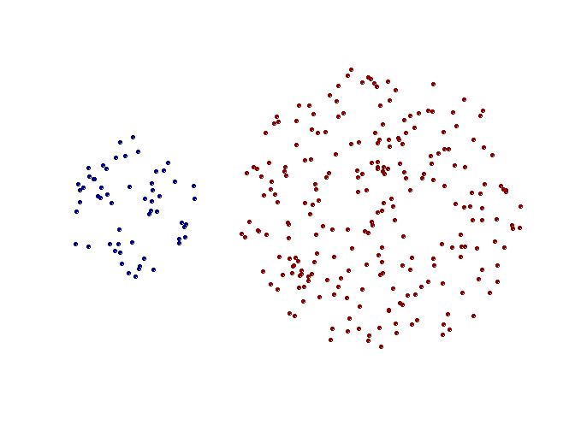
Strength of MIN
Original Points
Two Clusters
Can handle non-elliptical shapes

Slide 55
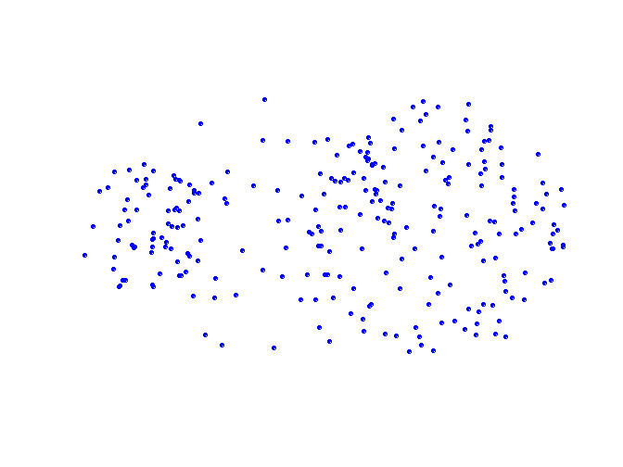
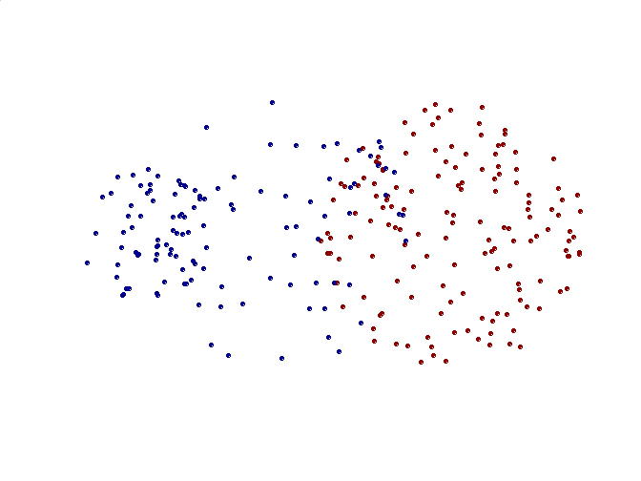
Limitations of MIN
Original Points
Two Clusters
Sensitive to noise and outliers

Slide 56
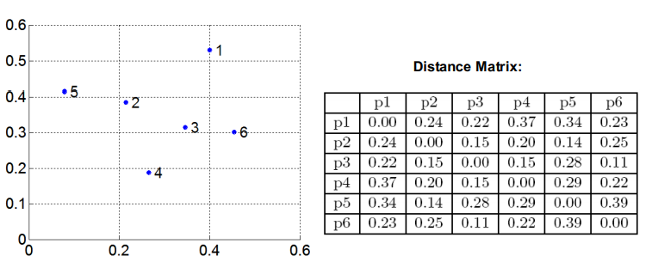
Cluster Similarity: MAX or Complete Linkage
Similarity of two clusters is based on the two least similar (most distant) points in the different clusters
Determined by all pairs of points in the two clusters

Slide 57
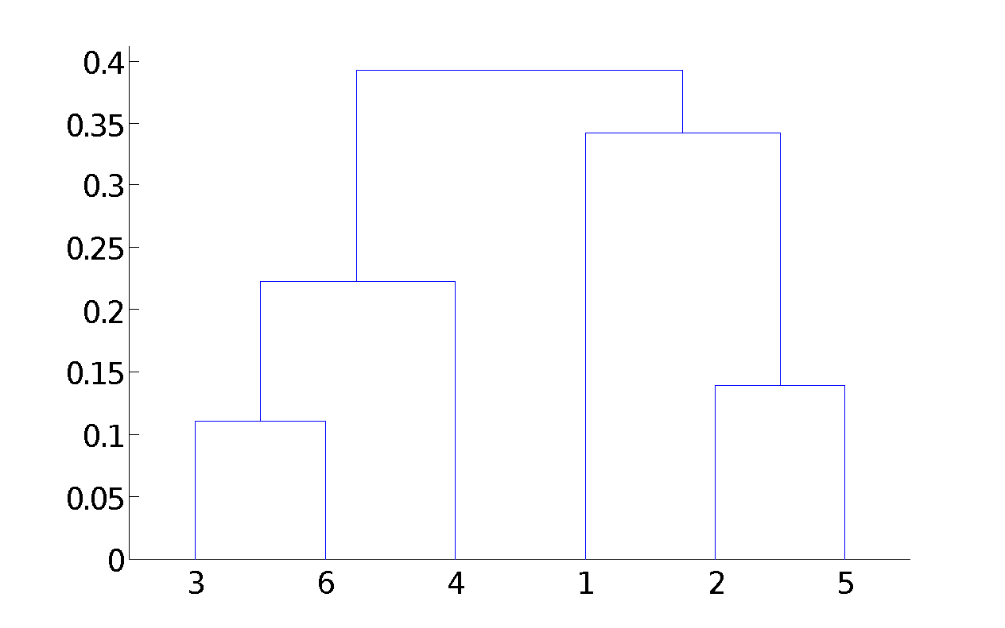
Hierarchical Clustering: MAX
4
1
2
5
5
2
3
6
3
1
4
Nested Clusters
Dendrogram

Slide 58
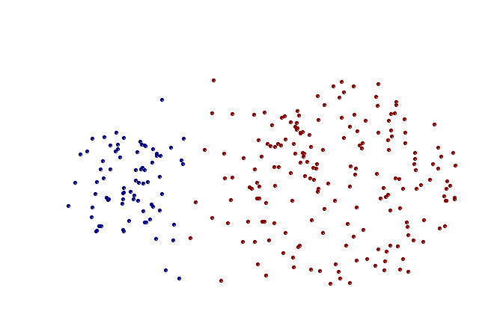
Strength of MAX
Original Points
Two Clusters
Less susceptible to noise and outliers

Slide 59
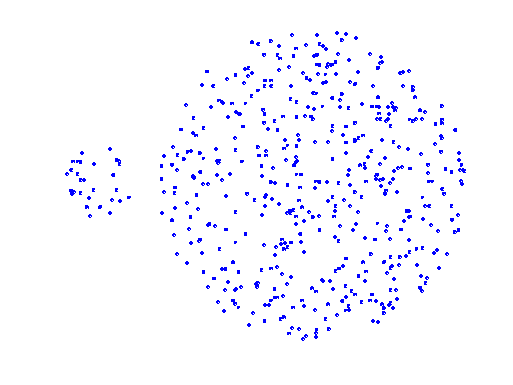
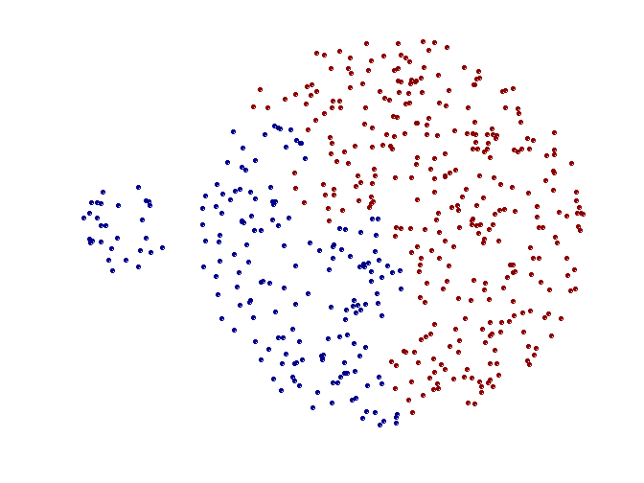
Limitations of MAX
Original Points
Two Clusters
Tends to break large clusters
Biased towards globular clusters

Slide 60

Cluster Similarity: Group Average
Proximity of two clusters is the average of pairwise proximity between points in the two clusters.
Need to use average connectivity for scalability since total proximity favors large clusters

Slide 61

Hierarchical Clustering: Group Average
5
4
1
2
5
2
3
6
1
4
3
Nested Clusters
Dendrogram

Slide 62
Hierarchical Clustering: Group Average
Compromise between Single and Complete Link
Strengths
Less susceptible to noise and outliers
Limitations
Biased towards globular clusters

Slide 63
Cluster Similarity: Ward’s Method
Similarity of two clusters is based on the increase in squared error when two clusters are merged
Similar to group average if distance between points is distance squared
Less susceptible to noise and outliers
Biased towards globular clusters
Hierarchical analogue of K-means
Can be used to initialize K-means

Slide 64
Hierarchical Clustering: Time and Space requirements
O(N²) space since it uses the proximity matrix.
N is the number of points.
O(N³) time in many cases
There are N steps and at each step the size, N², proximity matrix must be updated and searched
Complexity can be reduced to O(N² log(N) ) time for some approaches

Slide 65
Hierarchical Clustering: Problems and Limitations
Once a decision is made to combine two clusters, it cannot be undone
No objective function is directly minimized
Different schemes have problems with one or more of the following:
Sensitivity to noise and outliers
Difficulty handling different sized clusters and convex shapes
Breaking large clusters

Slide 66
Programming Assignment
Perform cluster validity task on your own choice of dataset:
Entropy and Purity of clusters
Cluster Cohesion and Separation
Submission deadline: April 20, 2020

Slide 67
References
Introduction to Data Mining by Tan, Steinbach, Kumar (Lecture Slides)
https://www.iula.upf.edu/materials/040701wanner.pdf

Slide 68
Questions!

